Slide 1
Digital Portfolio
STUDENT NAME: M.PRIYADHARSHINI
REGISTER NO AND NMID:
DEPARTMENT: COMPUTER SCIENCE
COLLEGE: COLLEGE/ UNIVERSITY SREE ABIRAAMI ARTS AND SCIENCE COLLEGE FOR WOMEN, GUDIYATHAM
FROMTHIRUVALLUR UNIVERSITY.

Slide 2
PROJECT TITLE
DIGITAL PORTFOLIO IN FRONT END DEVELOPMENT

Slide 3


AGENDA
Problem Statement
Project Overview
End Users
Tools and Technologies
Portfolio design and Layout
Features and Functionality
Results and Screenshots
Conclusion
Github Link
3/21/2024 Annual Review

Slide 4

PROBLEM STATEMENT
In today’s life style the known of the language in computer is easy but the technology is improved day by day for that we should be updated with our new programmable mind to produce new type of the coding in this digital world for that I had created my profile as students portfolio to be digitalises' with more innovative and the updation in this computerized world.

Slide 5

PROJECT OVERVIEW
A brief summary of my portfolio is given in this project as (about me, contacts, certificates and my skills as my personal development in this portfolio to explore my self to all in this digitalized world
Main theme is to the personal development and my skills , achivements and my certification and my project

Slide 6

WHO ARE THE END USERS?
Students(academic,projects,resumes)
Job seekers (to share with recruiter )
Freelancer(to show clients)
Professionals(to highlight experience and achievements)

Slide 7

TOOLS AND TECHNIQUES
1.Responsive Design – Adjusts layout for mobile,
tablet, and desktop.
2.Interactive Navigation – Smooth scrolling and hover
effects for better user experience.
3.Project Showcase – Clickable project cards with live
demo and GitHub links for deploy my project.
4.I had used the frontend languages like html ,css, JavaScript to build the portfolio .
I had used the platform like Github and visual studio code to complete this project
4.Contact Form – Collects user messages with
validation using JavaScript.

Slide 8
POTFOLIO DESIGN AND LAYOUT
Section included
About me/home
Projects
Skills
Contacts
Responsive layout
8

Slide 9
FEATURES AND FUNCTIONALITY
Navigation bar with smooth scrolling
Project showcase with images/details
Interactive elements (hover effects, animation)
Contact form(with validation)
Responsive design for all devices.

Slide 10
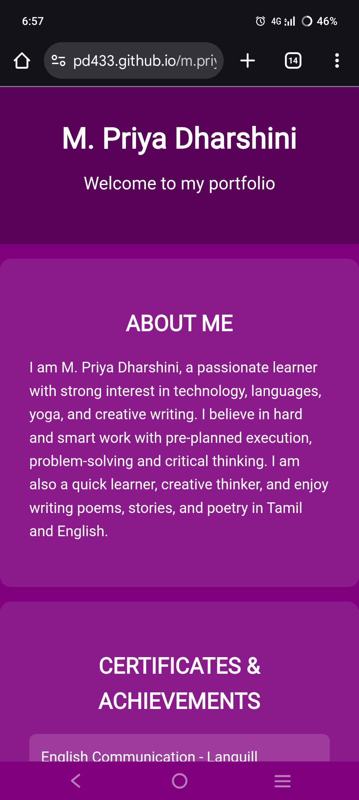
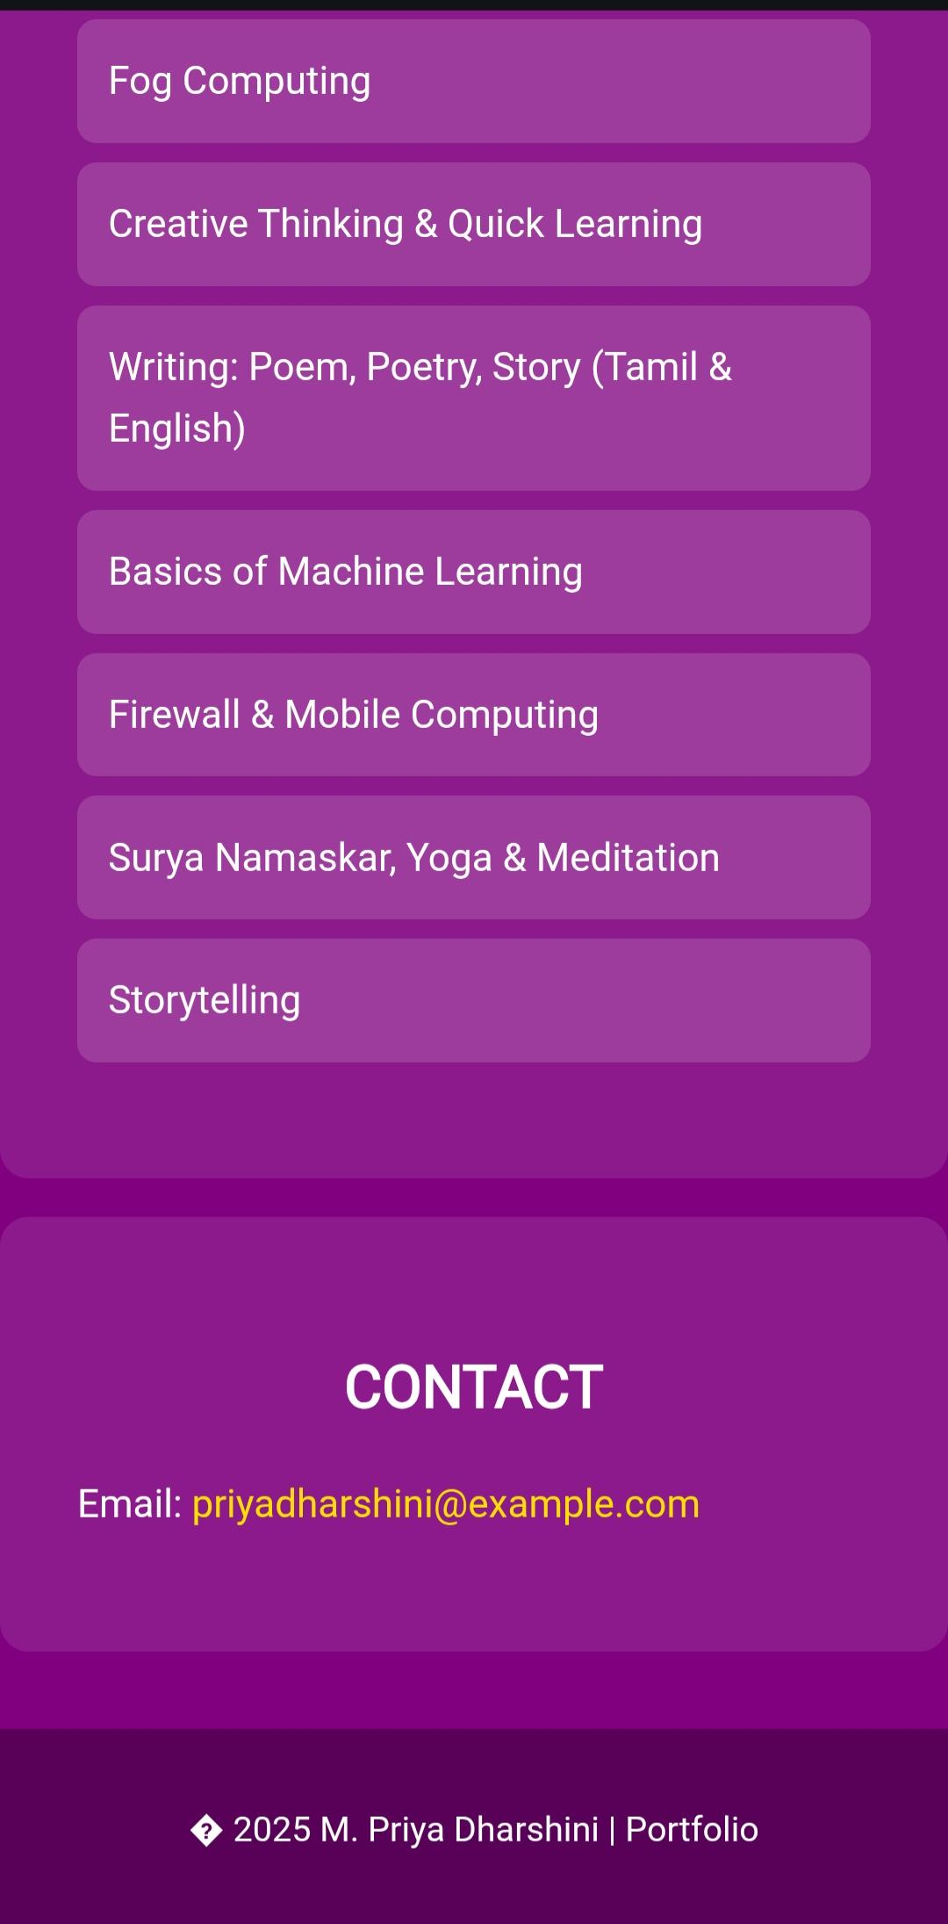

RESULTS AND SCREENSHOTS
3/21/2024 Annual Review
10

Slide 11
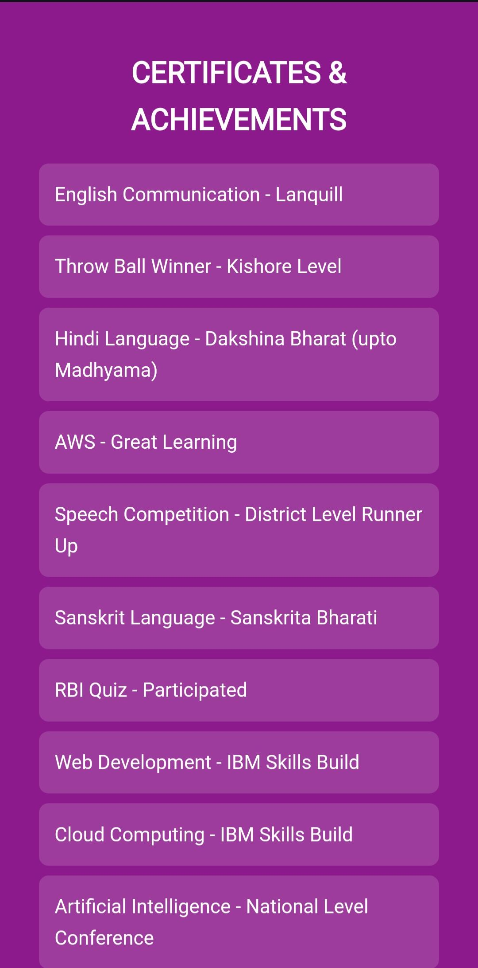
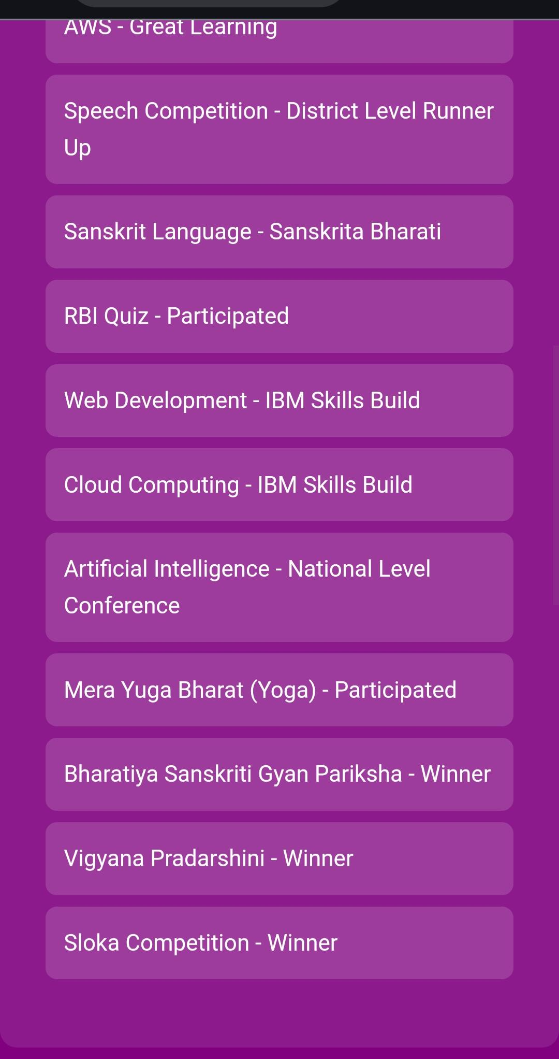

Slide 12
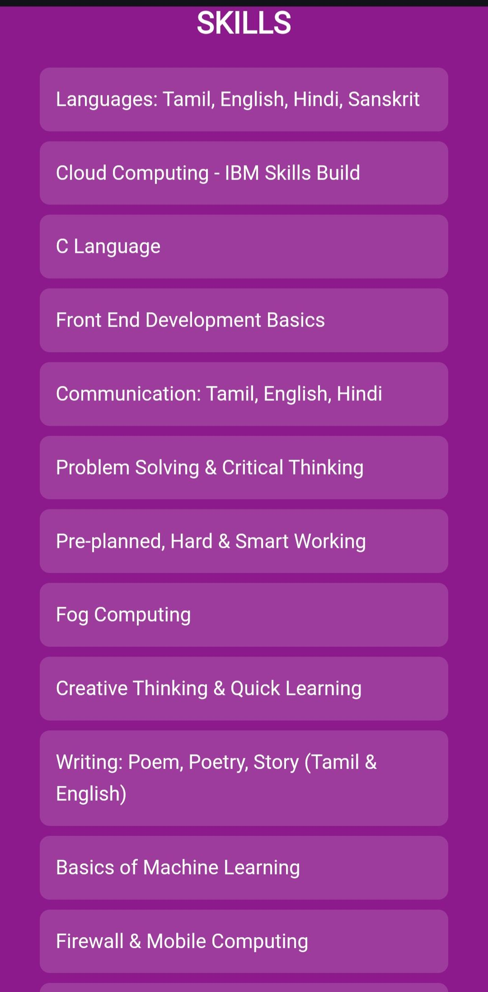
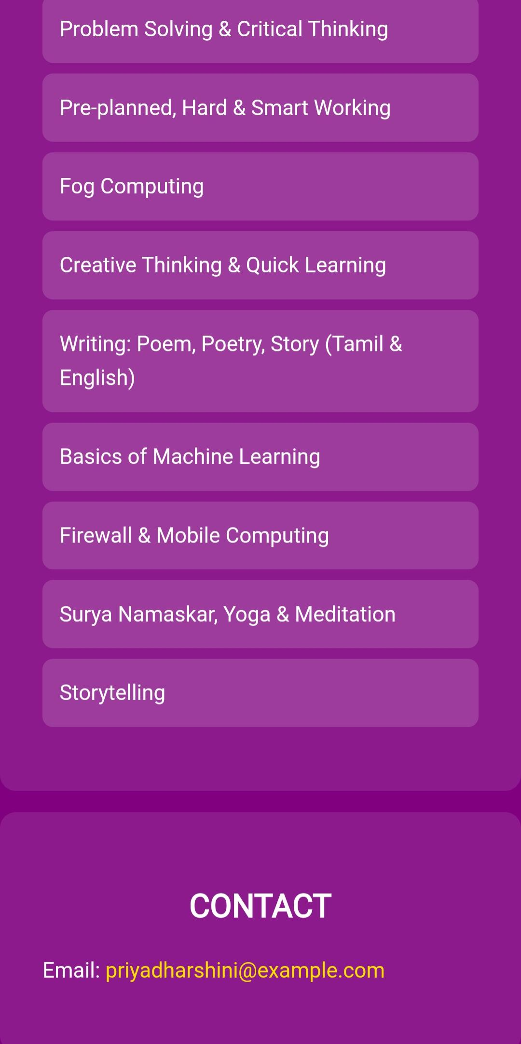

Slide 13
GITHUB AND PORTFOLIO LINK
This is my profile and my digital portfolio link .
MY GITHUB URL
. https://github.com/pd433
https://pd433.github.io/m.priyadharshiniportfolio/

Slide 14
CONCLUSION
It concluded with the front end language as htmls ,css as syling language JavaScript as the script language to develop my site more enhanced one in the website. I had used the visual studio code to run my all the programs It highlights my profile very much using this is helpful to build my platform much better
It benefits the society to digitalized one as the portfolio is easier to quick access of all the companies to visit the site as much very better experience it helps society more and more using digitalization
14

